Slide 1
PSI 90 PHYSICIAN ADVISOR AND CLINICAL DOCUMENTATION SPECIALIST PROCESS
Amy Steele BSN, RN, CCDS
CDI Manager, Palmetto Health, Columbia Campuses

Slide 2
Objectives
At the completion of this educational activity, the participant will be able to:
    Describe how the CDI specialist conducts a review for PSI 90.
    Identify when its time to escalate to the physician advisor for review.
    Discuss how queries can impact PSI rates.

Slide 4
How and why did we get started?
It was affecting out reimbursement. We were being penalized for Value Based purchasing
(PSI/HACs, Readmissions)
Our Hospital Compare Star rating did not match internal reports

Slide 5
Met in early 2017 with CFO, Quality team, Physicians Advisors, Coding, CDI
Coding Manager/CDI Manager reviewed PSI 90 cases in 2016
    Upon review, we found several charts that if queried could have changed the PSI
Attended the fall 2016 NCADIS Fall Conference at Wake Forrest and heard about their PSI review process
- Continued with PSI meetings

Slide 6
How can CDI help?

Slide 7
POA Status
Checking old records
Reviewing codes that coders used

Slide 8
Patient Safety Indicators 2018
  PSI 02 Death Rate in Low-Mortality Diagnosis Related Groups (DRGs)
  PSI 03 Pressure Ulcer Rate
  PSI 04 Death Rate among Surgical Inpatients with Serious Treatable Condition
  PSI 05 Retained Surgical Item or Unretrived Device Fragment Count
  PSI 06 Iatrogenic Pneumothorax Rate
  PSI 07 Central Venous Catheter-Related Blood Stream Infection Rate
  PSI 08 In Hospital Fall w/ Hip Fracture Rate
  PSI 09 Perioperative Hemorrhage or Hematoma Rate
PSI 10 Postoperative Acute Kidney Injury Requrering Dialysis
PSI 11 Postoperative Respiratory Failure Rate
PSI 12 Perioperative Pulmonary Embolism or DVT Rate
PSI 13 Postoperative Sepsis Rate
PSI 14 Postoperative Wound Dehiscence Rate
PSI 15 Unrecognized Abdominopelvic Accidental Puncture/Laceration Rate
PSI 16 Transfusion Reaction Count
PSI 17 Birth Trauma Rate – Injury to Neonate
PSI 18 Obstetric Trauma Rate – Vaginal Delivery with instrumentation
PSI 19 Obstetric Trauma Rate – Vaginal Delivery without instrumentation

Slide 9
PSI 90
PSI 03 Pressure Ulcer Rate
PSI 06 Iatrogenic Pneumothorax Rate
PSI 08 In-Hospital Fall With Hip Fracture Rate1
PSI 09 Perioperative Hemorrhage or Hematoma Rate
PSI 10 Postoperative Acute Kidney Injury Rate requiring dialysis
PSI 11 Postoperative Respiratory Failure Rate
PSI 12 Perioperative Pulmonary Embolism (PE) or Deep Vein Thrombosis (DVT) Rate
PSI 13 Postoperative Sepsis Rate
PSI 14 Postoperative Wound Dehiscence Rate
PSI 15 Unrecognized Abdominopelvic Accidental Puncture/Laceration Rate
Notes:
Very challenging beginning w/ R1 (sticky notes to alert ?? PSI manual process. How PA’s ‘thought’ things should be excluded.

Slide 10
Palmetto Health Statistics- 2017
CDI Reviewed a total of 108 Cases flagged for PSI
  30 Cases were able to be excluded for PSI by CDI due to AHRQ website guidelines or finding a query opportunity previously missed
  8 Cases were able to be excluded with Physician Advisors assistance and their medical knowledge and experience
    Do have some cases were the PSI is confirmed but we do not agree with AHRQ guidelines and working a way to notify AHRQ and hopefully change their guidelines on some of the PSIs

Slide 11
PROCESS
CDI OR CODING IDENTIFIES POSSIBLE PSI (concurrent or at dc)
CDI REVIEWS THE RECORD FOR EXCLUSION (once patient has dc’d)
CDI FORWARDS VIA ALLSCRIPTS TO PHYSICIAN ADVISOR FOR REVIEW IF NO EXCLUSION FOUND
PHYSICIAN ADVISOR WILL REVIEW FOR EXCLUSIONS
PHYSICIAN ADVISOR ENTERS REVIEW FINDINGS IN ALLSCRIPTS WITH CONFIRMATION OF PSI OR EXCLUSION CRITERIA
CDI then places answer into 3M and notifies coder to drop bill

Slide 12
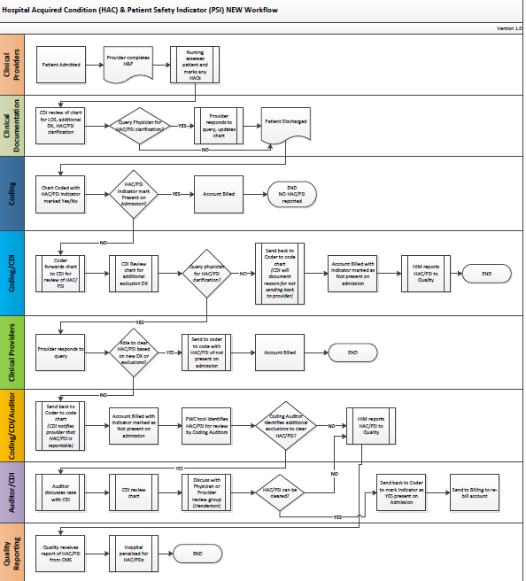

Slide 13
A quick review for automatic exclusion using AHRQ website…

Slide 14
PSI 03 Pressure Ulcer Rate
If the answer to any of the following is NO, the PU is excluded as a PSI 03
Was the patient 18 years or older?
Was the location of the pressure ulcer listed as a site that has been identified as a PSI 03 in the AHRQ website? (For example PU of the nose, ear, face, etc. are not considered PSI 03).
Was the hospital stay greater than 3 days?
If the answer to any the following questions is YES, the PU is excluded as a PSI 03
Was the length of stay less than 3 days?
Is there a principal diagnosis for pressure ulcer stage III or IV (or unstagable)?
  If more than one pressure ulcer is reported, all pressure ulcer must be present on admission for the record to be excluded.
Does the patient have severe burns (>= 20% body surface area)?
Does the patient have an exfoliative disorder of the skin (>= 20% body surface area)?
NOTE THAT PLEGIAS AND FACILITY TRANSFERS ARE NO LONGER AN EXCLUSION
If no exclusions identified here, please check website for other exclusions

Slide 15
PSI 06 Iatrogenic Pneumothorax Rate
If the answer to any of the following is NO, the pneumothorax is excluded as a PSI 06
Was the patient 18 years or older?
If the answer to any the following questions is YES, the pneumothorax is excluded as a PSI 06
Was the pneumothorax POA (as principal or secondary diagnosis POA)?
Did the patient have specified chest trauma (rib fracture, traumatic pneumothorax, and related chest wall injuries)?
Did the patient have a pleural effusion?
Did the patient have thoracic surgery?
Did the patient have a lung or pleural biopsy?
Did the patient have a diaphragmatic repair?
Did the patient have a cardiac procedure
Was this an obstetric case?sions identified here, please check website for other exclusions

Slide 16
PSI 08 In-hospital Fall With HIP Fracture
If the answer to any of the following is NO, the Hip fracture is excluded as a PSI 08
Was the patient 18 years or older?
Was this a hip fracture?
If the answer to any the following questions is YES, the hip fracture is excluded as a PSI 08:
Is the principal diagnosis (or secondary diagnosis POA) a hip fracture?
Is the principal diagnosis for seizure, syncope, stroke and occlusion of arteries, coma, cardiac arrest, poisoning, trauma, delirium and other psychoses, or anoxic brain injury?
Is there any listed diagnosis for metastatic cancer, lymphoid malignancy, or bone malignancy?
Is this an OB case?
If no exclusions identified here, please check website for other exclusions

Slide 17
PSI 09 Perioperative Hemorrhage Or Hematoma
If the answer to any of the following is NO, the hemorrhage or hematoma is excluded as a PSI 09
Was the patient 18 years or older?
Did the patient have surgery?
Was an additional procedure required to treat the hemorrhage or hematoma?
If the answer to any the following questions is YES, the hemorrhage or hematoma is excluded as a PSI 09
Was the hemorrhage or hematoma POA (as a principal or secondary POA diagnosis)?
Is the only operating room procedure related to fixing the hemorrhage or hematoma?
Was there a diagnosis of a coagulation disorder (for example; Pancytopenia, thrombocytopenia – see list on the website for additional examples)?
Was this an obstetric case?
If no exclusions identified here, please check website for other exclusions
www.qualityindicators.ahrg.gov

Slide 18
PSI 10 Postop Acute Kidney Injury Rate
If the answer to ANY of the following is NO, the POSTOP AKI is excluded as a PSI 10
Is the patient over 18?
Did the patient have an elective surgery?
Did the patient require dialysis?
If the answer to ANY the following questions is YES, the POSTOP AKI is excluded as a PSI 10
Was the acute kidney injury (AKI) POA as a primary or secondary diagnosis?
Did the dialysis take place before or the same day as the 1st Operating Room Procedure?
Was any dialysis access procedure occurring before or on the same day as the first operating room procedure?
Was there a cardiac dysrhythmia?
Was there shock?
Was there chronic kidney failure? (CKD 5 or ESRD)
Was there a urinary tract obstruction as PDx?
Is there POA of solitary kidney disease or was there a procedure done for a partial nephrectomy?
Was this an OB case?

Slide 19
PSI 11 Postop Respiratory Failure Rate
If the answer to ANY of the following is NO, the postop respiratory failure is excluded as a PSI 11
Is the patient over 18?
Did the patient have elective surgery?
If the answer to ANY of the following is YES, the postop respiratory failure is excluded as PSI 11
Was acute respiratory failure POA?
Was acute respiratory failure PDX?
Was a trach the only operating room procedure?
Any of the following present: certain neuromuscular and degenerative neurological disorders
Any listed procedure codes for laryngeal, pharyngel, nose, mouth, pharynx or facial surgery
Any listed procedure codes for esophageal resection, lung cancer, or lung transplant
Disease in MDC 4 respiratory, MDC 5 circulatory, or MDC 14 (obstetrics)

Slide 20
PSI 12 Perioperative PE/DVT Rate
If the answer to ANY of the following is NO, the perioperative PE/DVT is excluded as a PSI 12
Is the patient over 18?
Did the patient have surgery?
If the answer to ANY of the following is YES, the perioperative PE/DVT is excluded as a PSI 12
Was the PE/DVT POA?
Was the PE/DVT the PDX?
Did procedure for interruption of vena cava occur on or before the same day as the first O.R. procedure?
ECMO procedure?
Any acute brain or spinal cord injury POA – see list?
Did a pulmonary arterial thrombectomy occur before or the same day as the first operating room procedure or was the only operating room procedure?
Was this an obstetric case?
If no exclusions identified here, please check website for other exclusions – such as a surgical

Slide 21
PSI 13 Postoperative Sepsis Rate
If the answer to ANY of the following is NO, the postoperative sepsis is excluded as a PSI 13
Is the patient over 18?
Did the patient have elective surgery?
If the answer to ANY of the following is YES, the postoperative sepsis is excluded as a PSI 13
Was Sepsis POA?
Was sepsis the PDX?
Was any infection POA?
Was it an obstetric case?
If no exclusions identified here, please check website for other exclusions

Slide 22
PSI 14 Postop Wound Dehiscence Rate
If the answer to ANY of the following is NO, the postoperative wound dehiscence is excluded as a PSI 14
Is the patient over 18?
Did the patient have abdominopelvic surgery?
Did the patient have postop reclosure of the abdominal wall?
Was the hospital stay greater than 2 days?
If the answer to ANY of the following is YES, the postoperative wound dehiscence is excluded as a PSI 14:
Did the reclosure procedure occur on or before the day of the first abdominopelvic surgery?
Was the patient immunocompromised? If yes, check website for diagnoses that would exclude.
Is there a principal or secondary diagnosis code present on admission for disruption of internal operation wound?
Was this an obstetric case?
If no exclusions identified here, please check website for other exclusions

Slide 23
PSI 15 Unrecognized Abdominopelvic Accidental Puncture/Laceration Rates
If the answer to ANY of the following is NO, the unrecognized abdominopelvic accidental puncture/laceration is excluded as a PSI 15
Is the patient over 18?
Was there an accidental puncture or laceration during a procedure of the abd or pelvis?
Did the accidental puncture or laceration require a second abdominopelvic procedure one or more days after the procedure?
Was the accidental puncture or laceration a secondary diagnosis?
If the answer to ANY of the following is YES, the unrecognized abdominopelvic accidental puncture/laceration is excluded as a PSI 15
Was the puncture or laceration POA?
Was the puncture or laceration the PDX?
Obstetric case?
If no exclusions identified here, please check website for other exclusions

Slide 24
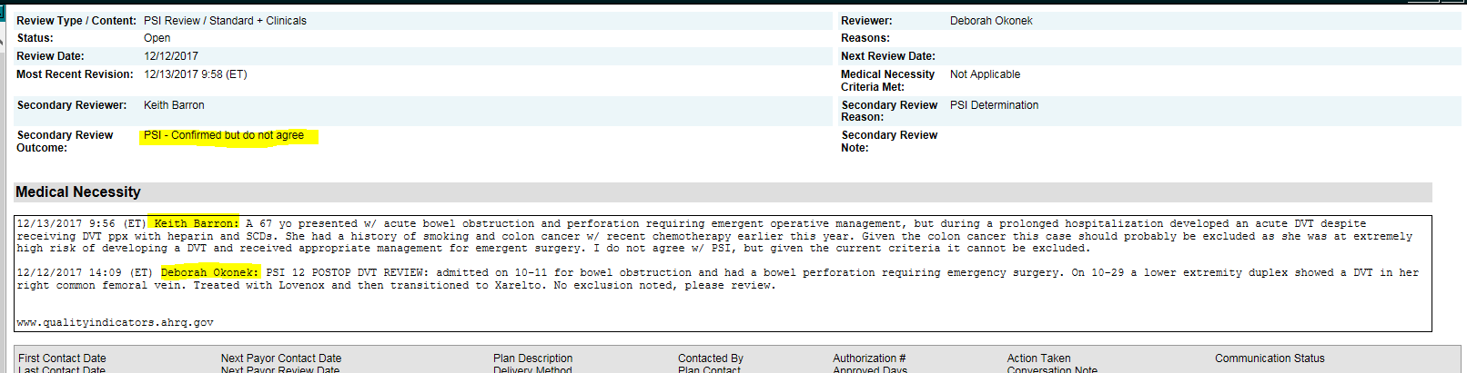
ALLSCRIPTS EXAMPLE

Slide 25
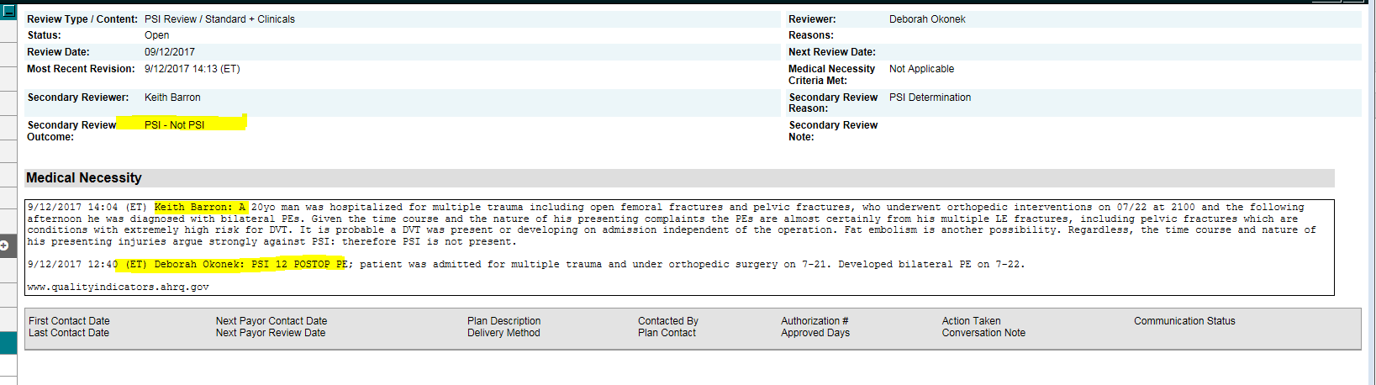

Slide 26
After CDI gets notification of a PA completing PSI review:
put response into 3M system
notify coding to drop bill
Add to spread sheet for tracking

Slide 27


Slide 28


